Slide 1
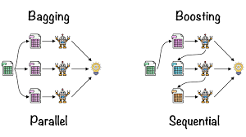
Ensemble Learning: The Core Idea
What is Ensemble Learning?
A technique that combines multiple models to improve performance.
Works on the principle: "The wisdom of the crowd."

Slide 2
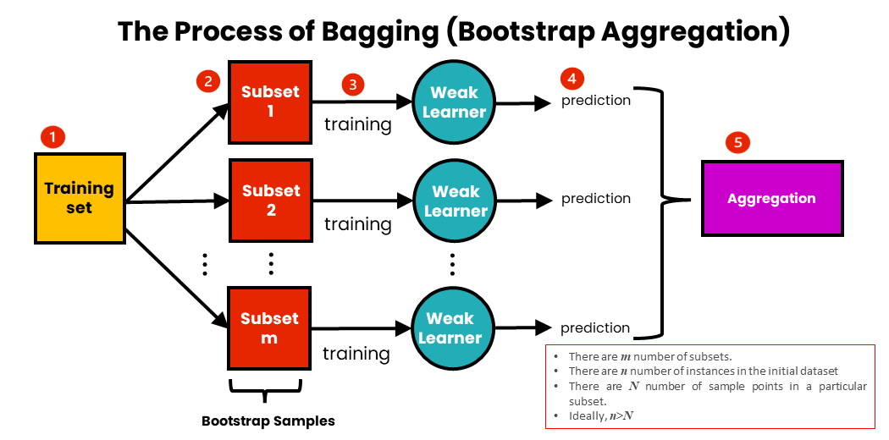
Bagging (Bootstrap Aggregating) Concept

Slide 3
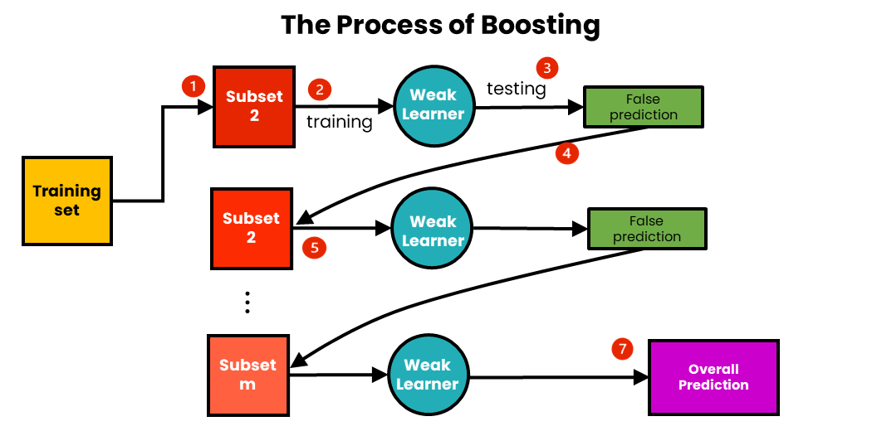
Introduction to Boosting
What is Boosting ?
Boosting is a process that uses a set of machine learning algorithms to combine weak learners to form a strong learner in order to increase the accuracy of the model.

Slide 4
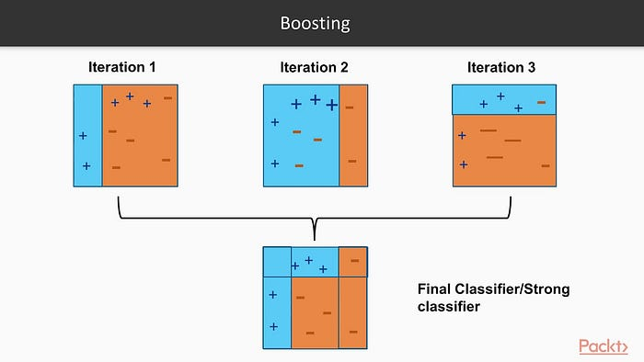
How does boosting algorithm works?
As I already mentioned, the basic principle of the boosting algorithm is to generate multiple weak learners and then combine their prediction to form a strong one.

Slide 5
How does boosting algorithm works?
All first three iteration is used to generate weak learner:
In the first iteration, as you can see the decision stump separate two positive sign. still, we are not able to separate three positive signs.
In the second iteration, decision stump divide two negative sign, and as we can see again decision stumps are unable to classify negative signs
In the third iteration, decision stump separate three positive and one negative sign.
The above weak learner is used to form a strong learner. And we are going to use that strong learner to build a model.

Slide 6
ALGORITHM:
step 1: The base algorithm reads the data and assigns equal weights to each sample observation.
step 2: False prediction is assigned to the next base learner with a higher weight on these incorrect predictions.
step 3:Repeat step 2 until the algorithm can correctly classify the output.

Slide 7
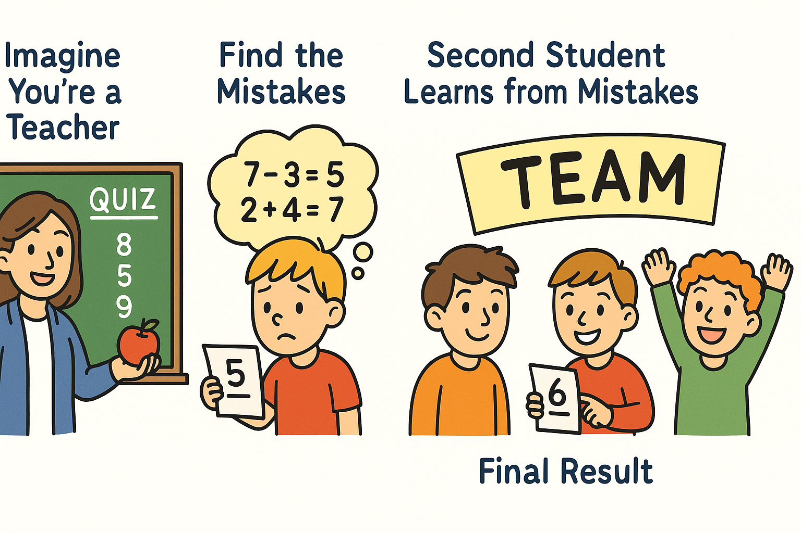
ALGORITHM:

Slide 8
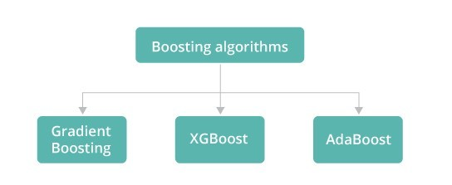
Types of Boosting algorithms
Adaptive boosting
Gradient Boosting
Xgboosting

Slide 9
Adaptive Boosting
The base algorithm reads the data and assigns equal weights to each sample observation.
False prediction is assigned to the next base learner with a higher weight on these incorrect predictions.
Repeat step 2 until the algorithm can correctly classify the output.

Slide 10
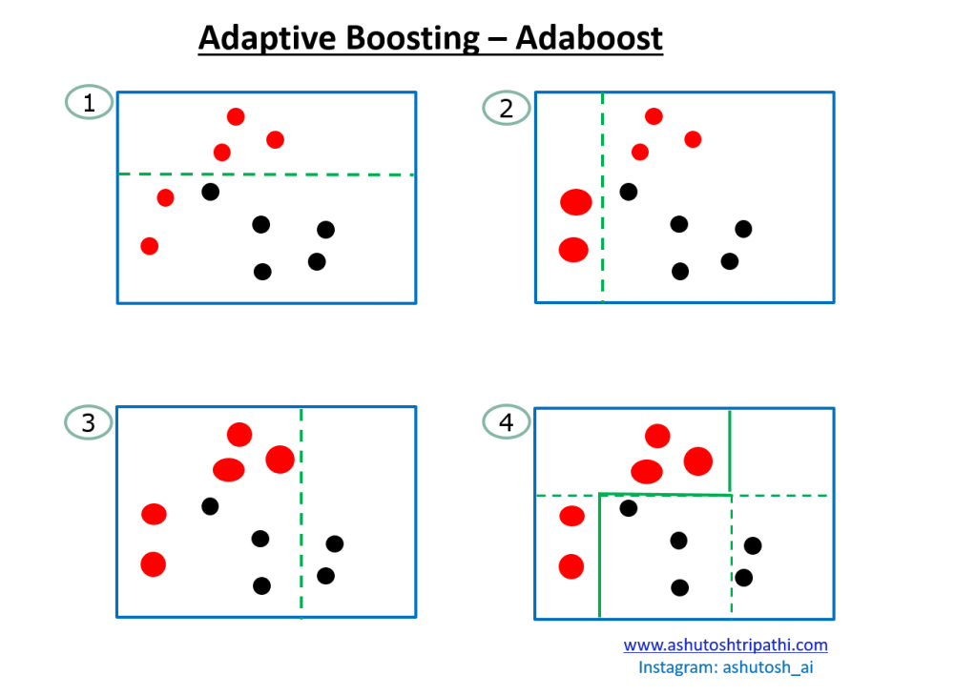
Adaptive Boosting

Slide 11
Gradient Boosting
In gradient boosting, base learner-generated sequentially in such a way that the present base learner is always more effective than the previous one.
In Gradient boosting having following three main components:
The loss function needs to be optimized.
Weak learners are used to computing predictions and forming a strong one.
An additive model that will regularize the loss function.

Slide 12
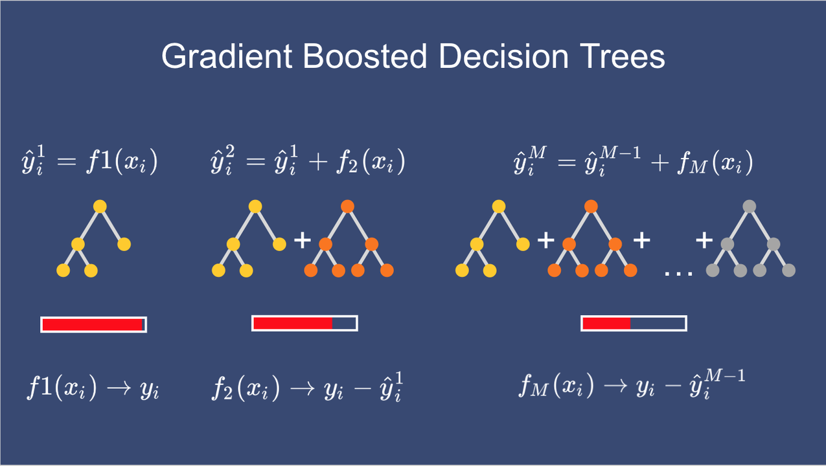
Gradient Boosting

Slide 13
XgBoosting
XgBoost is more efficient and optimized in the above two.
XgBoosting is an advanced version of the gradient boosting method that is designed to focus on computational speed and model efficiency.
The reason behind the speed is, XgBoost follows parallelization, distributed computing, and cache optimization.

Slide 14
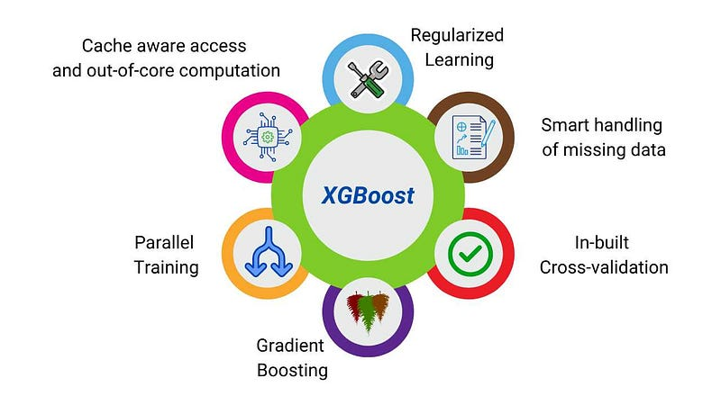
XgBoosting

Slide 15
Thank You

